Slide 1
Team Members:
L. Bhupala Vignesh-2022BCSE07AED283
C. Rajiv naidu-2022BCSE07AED313
Y.Pavan Kumar Reddy 2022BCSE07AED363
B. Mokshagna Akhileswara Reddy-2022BCSE07AED387
Name of the Faculty: Sridhar Devarajan
Name of the Project: Personal Dairy Management

Slide 2
Agenda
Problem Statement (Brief description as points)
Introduction
Objectives (Brief description as points)
Requirements (Hardware and Software)
System Architecture
Module Descriptions (Algorithm, source code and screen shots)
Conclusion
Advantages of the project
Limitations of the project
Future Enhancements

Slide 3
Problem Statement
In today's digital world, many individuals look for convenient ways to document their personal experiences, daily thoughts, and important events. While digital diaries are widely available, most of them fall short in ensuring user privacy and data security. Storing sensitive personal information without proper encryption makes it vulnerable to unauthorized access, data breaches, or tampering. This creates a strong need for a secure digital diary system that not only provides essential diary functionalities like adding, viewing, editing, and deleting entries but also ensures that the content remains private and accessible only to the rightful user. To address this gap, a secure, user-friendly diary management system must be developed with features such as encrypted data storage, user authentication, and a clean, intuitive interface.

Slide 4
Introduction
The Personal Diary Management system is a secure web-based application designed to help users maintain a private digital diary. In an age where data privacy is more important than ever, this project focuses on providing a platform where individuals can safely record their thoughts, events, and daily experiences. Built using Python and Flask for the backend and HTML for the frontend, the application emphasizes both usability and security. Each user can create an account, log in securely, and manage their personal diary entries through an intuitive dashboard. To ensure data confidentiality, all diary entries are encrypted and stored in binary format, accessible only to the authenticated user. This project showcases a practical implementation of privacy-focused design in everyday digital applications.

Slide 5
Objectives
The primary objective of the Personal Diary Management system is to provide a secure and user-friendly platform for individuals to create, manage, and protect their personal diary entries. This project aims to ensure complete privacy through strong encryption techniques, allowing only authenticated users to access their data. Additionally, it focuses on implementing core diary functionalities—such as adding, viewing, editing, and deleting entries—within a simple and intuitive interface. Another key objective is to manage user authentication securely by storing passwords in a hashed format and safeguarding user credentials. Overall, the system is designed to combine the convenience of digital note-keeping with the essential need for personal data security.

Slide 6
Requirements
Software Requirements:
Programming Language: Python
Web Framework: Flask
Frontend: HTML (with optional CSS for styling)
Encryption Library: cryptography (for AES encryption/decryption)
Data Handling: pickle (for storing user data securely)
Password Security: werkzeug.security (for hashing and verifying passwords)
IDE/Editor: Visual Studio Code (VS Code) or any Python-supported
IDEBrowser: Any modern web browser (e.g., Chrome, Firefox) for accessing the web interface

Slide 7
Requirements
Hardware Requirements:
A computer with minimum:
Processor: Intel i3 or equivalent
RAM: 4 GB or higher
Storage: Minimum 500 MB free space
Stable internet connection (optional, if deploying to a remote server)

Slide 8
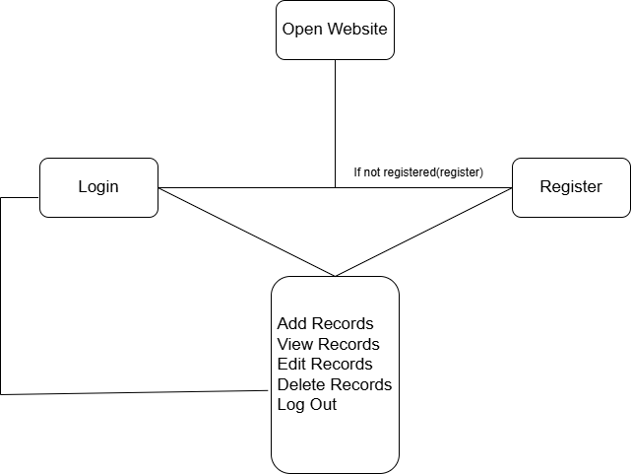
System Architecture

Slide 9
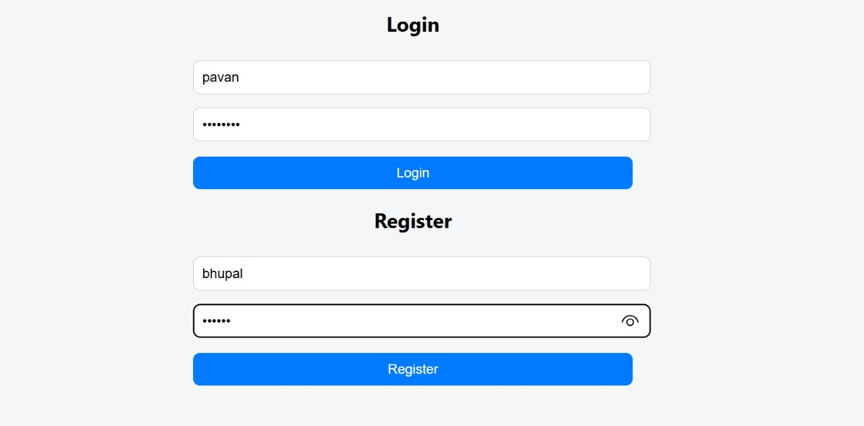
Module Descriptions (Algorithm, source code and screen shots)
User Authentication Module
from werkzeug.security import generate_password_hash, check_password_hash
def register_user(username, password):
hashed_password = generate_password_hash(password)
users[username] = hashed_password
save_users()
def authenticate_user(username, password):
return username in users and check_password_hash(users[username], password)

Slide 10
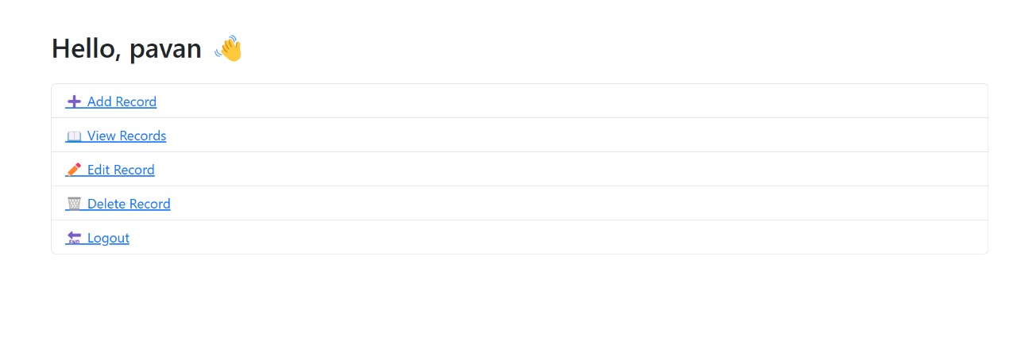
Module Descriptions (Algorithm, source code and screen shots)
Diary Entry Management Module
def save_entry(username, date, content):
encrypted_data = encrypt(content)
with open(f"{username}_{date}.bin", "wb") as file:
file.write(encrypted_data)
)

Slide 11
Module Descriptions (Algorithm, source code and screen shots)
Encryption Module
from cryptography.fernet import Fernet
with open("secret.key", "rb") as key_file:
key = key_file.read()
cipher = Fernet(key)
def encrypt(data):
return cipher.encrypt(data.encode())
def decrypt(token):
return cipher.decrypt(token).decode()
Flask Web Server Module
@app.route("/add", methods=["POST"])
def add_entry():
content = request.form["content"]
save_entry(session["username"], date.today(), content)
return redirect("/dashboard")

Slide 12
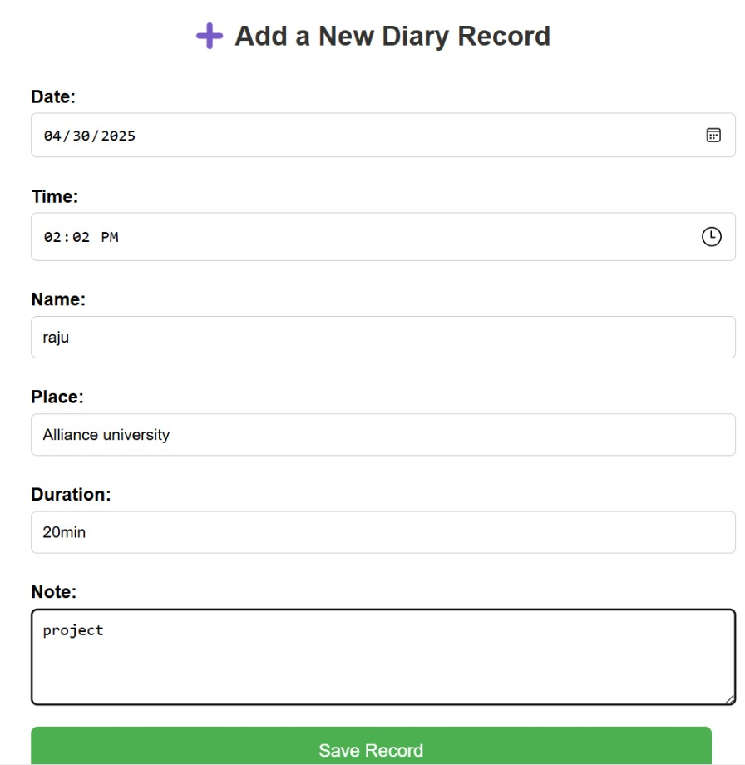
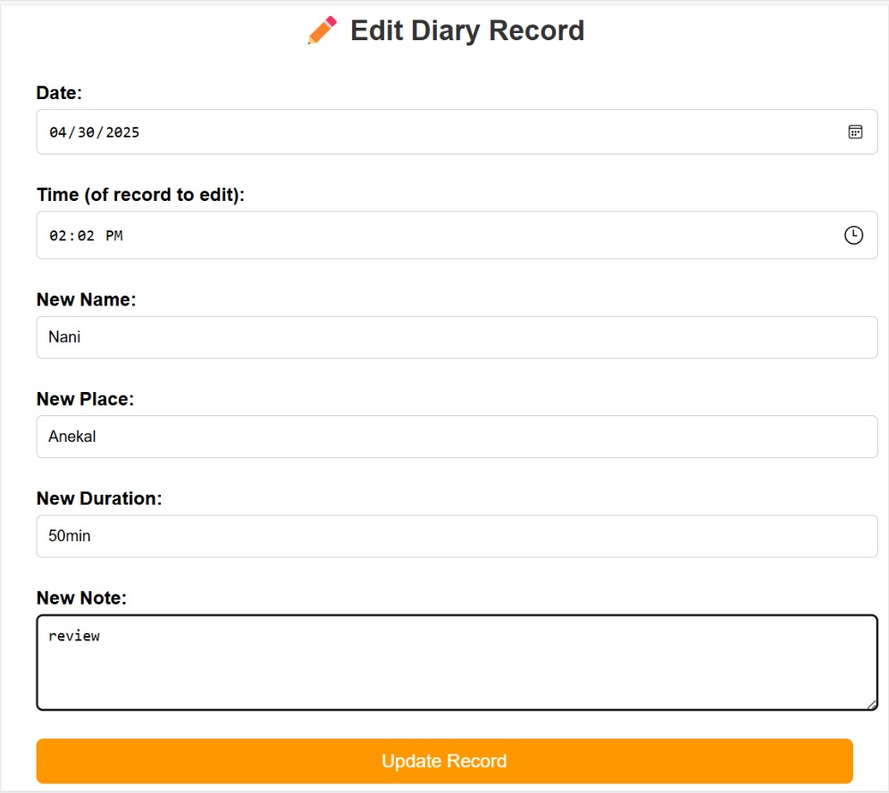
Module Descriptions (Algorithm, source code and screen shots)

Slide 13
Conclusion
The Personal Diary Management system successfully demonstrates how a simple digital diary can be enhanced with strong security and privacy features. By integrating user authentication, AES-based encryption, and secure file handling, the application ensures that personal data remains confidential and accessible only to the rightful owner. The system is user-friendly and offers essential diary functionalities while maintaining a focus on protecting sensitive information. This project not only highlights the importance of secure data handling in personal applications but also provides a practical implementation of core web development and cryptography concepts. It serves as a solid foundation for further enhancements, such as cloud storage integration or mobile app development.

Slide 14
Advantages of the Project
Enhanced Security: Uses AES encryption to protect diary entries, ensuring that personal data remains confidential.
Secure Login System: User authentication with hashed passwords prevents unauthorized access.
User-Friendly Interface: Simple and intuitive HTML frontend makes it easy for users to navigate and manage entries.
Offline Storage: Data is stored locally in encrypted .bin files, reducing dependency on external servers or internet access.
Modular Codebase: The system is built with clean, modular Python code, making it easy to understand, maintain, and extend.
Fast and Lightweight: Runs smoothly on basic hardware without requiring heavy resources or complex installations.
Customizable: Easily expandable for features like mood tracking, search functionality, or backup systems.

Slide 15
Limitations of the Project
No Cloud Backup: Data is stored locally, so entries can be lost if the local files are deleted or corrupted.
No Mobile Support: The current system is designed for desktops and is not optimized for mobile or tablet use.
Single User per Session: The system doesn’t support multi-user concurrency or session management over the internet.
No Advanced Features: Features like text search, tagging, reminders, or mood tracking are not yet implemented.
Static Interface: Basic HTML interface without CSS styling or dynamic JavaScript elements for a richer user experience.
Manual Key Management: The encryption key is stored locally and may be compromised if not protected properly.
Limited Testing: The system hasn’t been extensively tested for scalability or security vulnerabilities.

Slide 16
Future Enhancements
Cloud Integration: Enable secure cloud backup to allow users to access their diary entries from any device, anywhere.
Mobile App Development: Create a responsive web or mobile application (Android/iOS) for better usability on smartphones and tablets.
Search and Filter Options: Add search functionality to help users quickly find entries by keywords, tags, or dates.
Improved UI/UX Design: Enhance the frontend using CSS and JavaScript for a modern, dynamic, and visually appealing interface.
Reminder and Notification System: Implement reminders for users to write entries or revisit past entries on anniversaries.
AI-Based Sentiment Analysis: Analyze diary content to give users insights into their mood patterns over time.
Role-Based Access Control: Introduce admin or multi-user roles for extended use cases like shared journals or family diaries.
Enhanced Encryption: Upgrade to more robust encryption strategies or allow users to manage their own encryption keys securely.
Dashboard Analytics: Provide users with a dashboard showing statistics like total entries, writing frequency, and mood trends.

